Slide 1

PSYCHOLOGICAL DISORDER ASSESMENT USING ML & NLP​
Presentation by:​​
Souvik Naskar​​
Rajdeep Mallick​​
Arup Kumar Roy​​
Under the guidance of:​​
Prof. Sruti Gan Chaudhuri​​
Jadavpur University​​

Slide 2
TABLE OF CONTENTS​
First Part Work & Limitations
Introduction to Second Part
Dataset Overview
Implemented NLP Pipeline
Text Preprocessing Steps Overview
Word Embeddings
Model Experimentation
Results And Findings
Comparative Study Of Findings
Testing With Demo Data
Limitations and Future Work
Conclusion
References

Slide 3
FIRST PART WORK
Developed an explainable decision tree model for diagnosing anxiety, stress, and depression.
Key phases: data transformation, encoding, attribute segregation, query elimination, training, testing, and prediction explanation.
Used methods like Permuted Feature Importance and Contrastive Explanation for interpretability.

Slide 4
FIRST PART LIMITATIONS
Proposed Model did not achieve desired accuracy for predicting disorders.
Q-Prioritization for feature selection reduced model accuracy.
The data had zero complexity with well-defined boundaries, allowing traditional models to achieve 100% accuracy.
These issues led to the 2nd part of the project, focusing on stress detection from social media text using NLP.

Slide 5


INTRODUCTION TO SECOND PART
OBJECTIVES
IMPORTANCE
Compare NLP models for detecting stress in Reddit posts.
Evaluate our models against the original research.
Early stress detection aids mental health.
Public Health Monitoring.
Offers personalized user support.

Slide 6
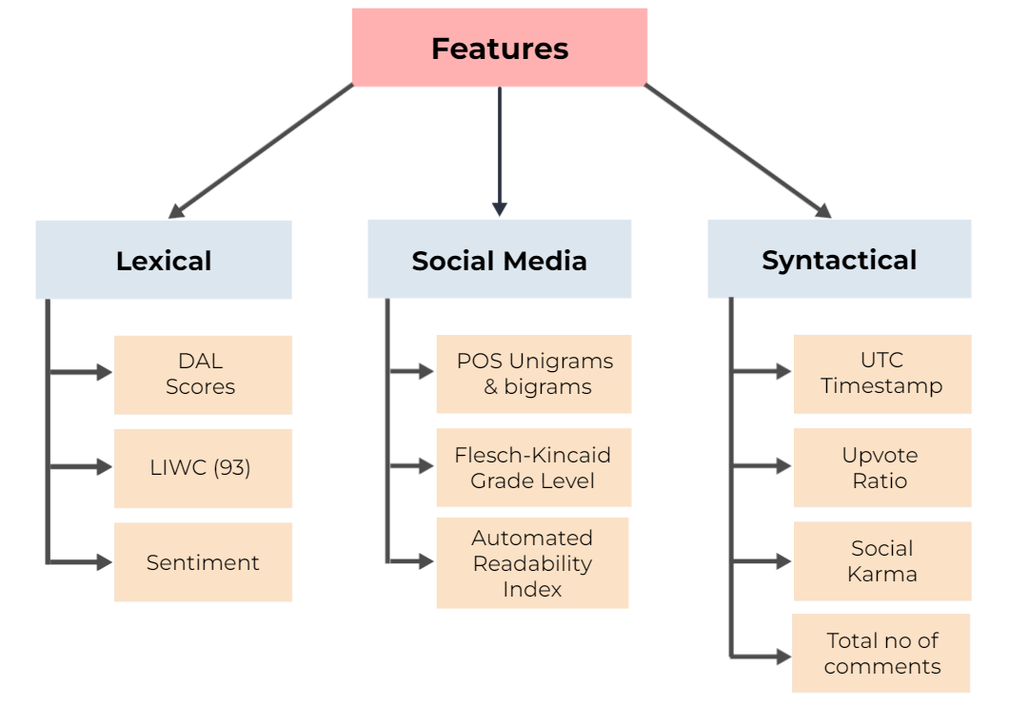
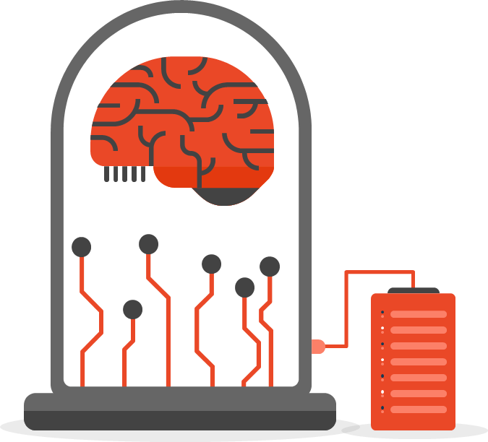
DATASET OVERVIEW
Corpus: Reddit post body, subreddit name and various features.
Labels: "Stress" (1) or "Not Stress" (0).
Confidence: Agreement threshold for data.
Total Posts: 3,553.
Stressful Posts: 52.3%.

Slide 7




IMPLEMENTED NLP PIPELINE
Post Body (Text)
Text Preprocessing
Word Embeddings
Dataset
Train Models
Evaluation
Various Features
Selected Features + Embeddings

Slide 8
TEXT PREPROCESSING
01
Fix Contractions
05
Remove URLs
09
Tokenization
02
Lowercasing
06
Remove Numbers
10
Remove Stopwords
03
Replace Emojis
07
Remove Punctuations
11
Stemming
04
Remove
HTML Tags
08
Chat Word Replacement
12
Lemmatization

Slide 9
TEXT PREPROCESSING
STEMMING VS LEMMATIZATION
Stemming | Lemmatization
Removes suffixes based on rules (e.g., "ing", "ed") | Converts words to their dictionary base form (lemma) through morphological analysis
"running" -> "runn" (may not be a real word) "agreed" -> "agre" "happier" -> "happi" | "running" -> "run" (correct base form) "agreed" -> "agree" (correct base form) "happier" -> "happy" (correct base form)
Models: Porter Stemmer | Models: WordNet Lemmatizer, spacy

Slide 10
TEXT PREPROCESSING
Original Text | Preprocessed Text
Deadline looming, code crashing, client demanding revisions, coffee spilled, internet down, pressure mounting, errors multiplying, time slipping away, stress levels skyrocketing, chaos consuming, panic setting in, breathe! | deadline loom code crash client demand revision coffee spill internet pressure mount error multiply time slip away stress level skyrocket chaos consume panic set breathe
Why does everything always have to be so complicated? It feels like I'm drowning in a sea of never-ending tasks, deadlines, and expectations. Can't catch a break even for a moment. When will this relentless cycle of stress ever end? | everything always complicated feel like drown sea never ending task deadline expectation catch break even moment relentless cycle stress ever end
Okay, So in since October have just got out of an eight year relationship . We were engaged to get married next year, but it did not work out. It ended mutually and we have moved on. In life these things happen. Since Halloween I have been seeing this Girl. | okay since october get eight year relationship engage get marry next year work end mutually move life thing happen since halloween see girl

Slide 11
WORD EMBEDDINGS
Original Research
Our Work
Bag-of-n-grams (n ∈ {1..3})
Google News pre-trained Word2Vec (300 D)
Domain Word2Vec (300 D)
BERT
Bag-of-words (n = 1)
TF-IDF
Google News pre-trained Word2Vec (300 D)
Domain Word2Vec (300 D)
Wikipedia News pre-trained Fasttext
BERT
Vs

Slide 12
MODEL EXPERIMENTATION
Traditional Machine Learning
Support Vector Machines (SVMs)
Logistic Regression
Naive Bayes (Multinomial, Bernoulli, Gaussian)
Random Forest
Gradient Boosting
ModelsUsed
Neural Networks
Artificial Neural Networks (ANN) : 1 or 2 dense layers
LSTM (Long Short-Term Memory)
Bi-LSTM (Bidirectional LSTM)
GRU (Gated Recurrent Unit)

Slide 13

MODEL EXPERIMENTATION
Only Word Embeddings With Any Confidence
(All Models)
01
Only Word Embeddings With 80% Confidence
(All Models)
02
Word Embeddings + Features With Any Confidence
(Except LSTM, BI-LSTM, GRU)
03
Word Embeddings + Features With 80% Confidence
(Except LSTM, BI-LSTM, GRU)
04
Setup

Slide 14
RESULT AND FINDINGS

Slide 15
RESULT AND FINDINGS

Slide 16
RESULT AND FINDINGS

Slide 17
RESULT AND FINDINGS

Slide 18
RESULT AND FINDINGS
Comparative Study
 | Precision | Recall | F1-Score | Confidence | Features | Embedding | Model
Original Research Paper | 74.33 | 83.2 | 79.8 | 80% | |r| >= 0.4 | Domain Word2Vec | LogReg
Our Work | 77.56 | 79.13 | 78.34 | Any | All | Pretrained Word2Vec | ANN
 | 80.86 | 86.25 | 83.47 | 80% | All | Bag of Words | ANN
 | 74.79 | 77.39 | 76.86 | Any | None | Fasttext | ANN
 | 81.12 | 84.17 | 82.62 | 80% | None | Fasttext | ANN
|r| = magnitude of their Pearson correlation

Slide 19
TESTING WITH DEMO DATA
Test Statements | Prediction with Fasttext Model (Any Confidence, Features = None and F1 = 76.86) |  | Prediction with Fasttext Model (80% Confidence, Features = None and F1 = 82.33)
 | Probability | Result | Probability | Result
Deadline looming, code crashing, client demanding revisions, coffee spilled, internet down, pressure mounting, errors multiplying, time slipping away, stress levels skyrocketing, chaos consuming, panic setting in, breathe! | 0.8691734 | Stress | 0.9495 | Stress
Why does everything always have to be so complicated? It feels like I'm drowning in a sea of never-ending tasks, deadlines, and expectations. Can't catch a break even for a moment. When will this relentless cycle of stress ever end? | 0.8495 | Stress | 0.8978 | Stress
Taking a moment to breathe and appreciate the little joys in life can really make a difference. Sometimes a simple walk outside or a warm cup of tea is all it takes to brighten the day. | 0.0369 | No Stress | 0.0253 | No Stress
It feels like I'm constantly racing against time, trying to keep up with endless demands. Just when I think I'm catching my breath, another wave of responsibilities crashes down. It's exhausting, and I can't shake off this feeling of being overwhelmed. | 0.8691 | Stress | 0.9394 | Stress
Today is such a beautiful day! The sun is shining, birds are singing, and everything just feels so peaceful. I'm grateful for moments like these that remind me of the simple joys in life. 😊 | 0.1037 | No Stress | 0.0673 | No Stress

Slide 20

LIMITATIONS AND FUTURE WORK
LIMITATIONS
Small dataset limits model performance.
Models struggle with implicit stress.
Difficulty in identifying stress focused on others.
Incomplete consideration of writer's framing and intention.
FUTURE WORK
Use unlabeled data to enhance model performance.
Develop models considering writer's framing and intention.
Investigate stress causes and effects, not just detection.
Create distant supervision techniques to expand labeled data.

Slide 21

CONCLUSION
The project addresses mental stress detection in social media posts via NLP and ML/DL techniques.
It highlights the efficacy of Fasttext embeddings, particularly with ANN models.
Traditional methods like BoW and Word2Vec outperform when combined with extracted features.
Suggests establishing benchmarks for Reddit datasets to aid stress level categorization.
Emphasizes potential support provision for mental health issues on social media.

Slide 22

REFERENCES
Dreddit dataset: Link
Stress Analysis on Social Media Paper: Link
Machine Learning Driven Mental Stress Detection on Reddit Posts Using Natural Language Processing: Link
Detection and Analysis of Stress-Related Posts in Reddit’s Acamedic Communities: Link
Fasttext documentation: Link
OUR WORK
Google Drive link for all work files: Link

Slide 23


